Slide 1

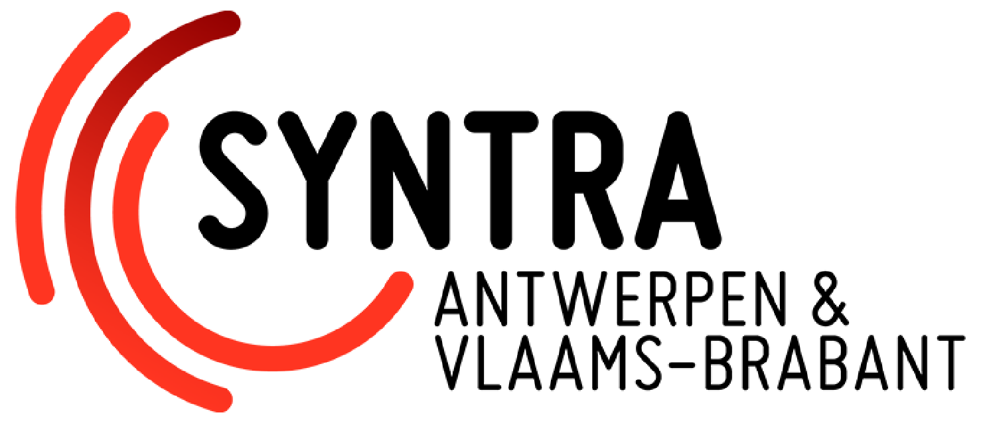
Source Control

Slide 2

Source Control
Source Control
Allows collaboration, reverting to previous versions, and maintaining a comprehensive history
Also known as version control, tracks changes to code and data over time

Slide 3

Essential Features of Source Control Systems
Version Tracking: Maintains a detailed history of changes to track project evolution
Branching and Merging: Enables separate code branches for different features or bug fixes
Collaboration and Conflict Resolution: Facilitates collaboration among multiple developers

Slide 4
GIT
Advantages of Git
Open-source and widely used, with a large community and extensive documentation
Lightweight and efficient, suitable for personal and small-team projects
Flexible branching and merging capabilities for experimental development
Disadvantages of Git
Challenging to manage complex branching scenarios and large codebases
May not be as suitable for large-scale enterprise environments
Requires additional tools for integration with Unreal Engine

Slide 5
Perforce
Advantages of Perforce
Proven track record in the game development industry
Robust and scalable, suitable for large and complex projects
Centralized control provides a consistent codebase
Disadvantages of Perforce
Proprietary software with a commercial license
More complex to set up and use compared to Git
Less userfriendly interface compared to newer tools

Slide 6
Plastic SCM
Advantages of Plastic SCM
Powerful branching and merging capabilities for complex scenarios
User-friendly interface and streamlined workflows
Hybrid centralized/distributed model offers flexibility and scalability
Disadvantages of Plastic SCM
Proprietary software with a commercial license
May not be as fast as Git for large projects
Less widespread adoption compared to Git

Slide 7
GIT
Let’s have a look!

